Slide 1
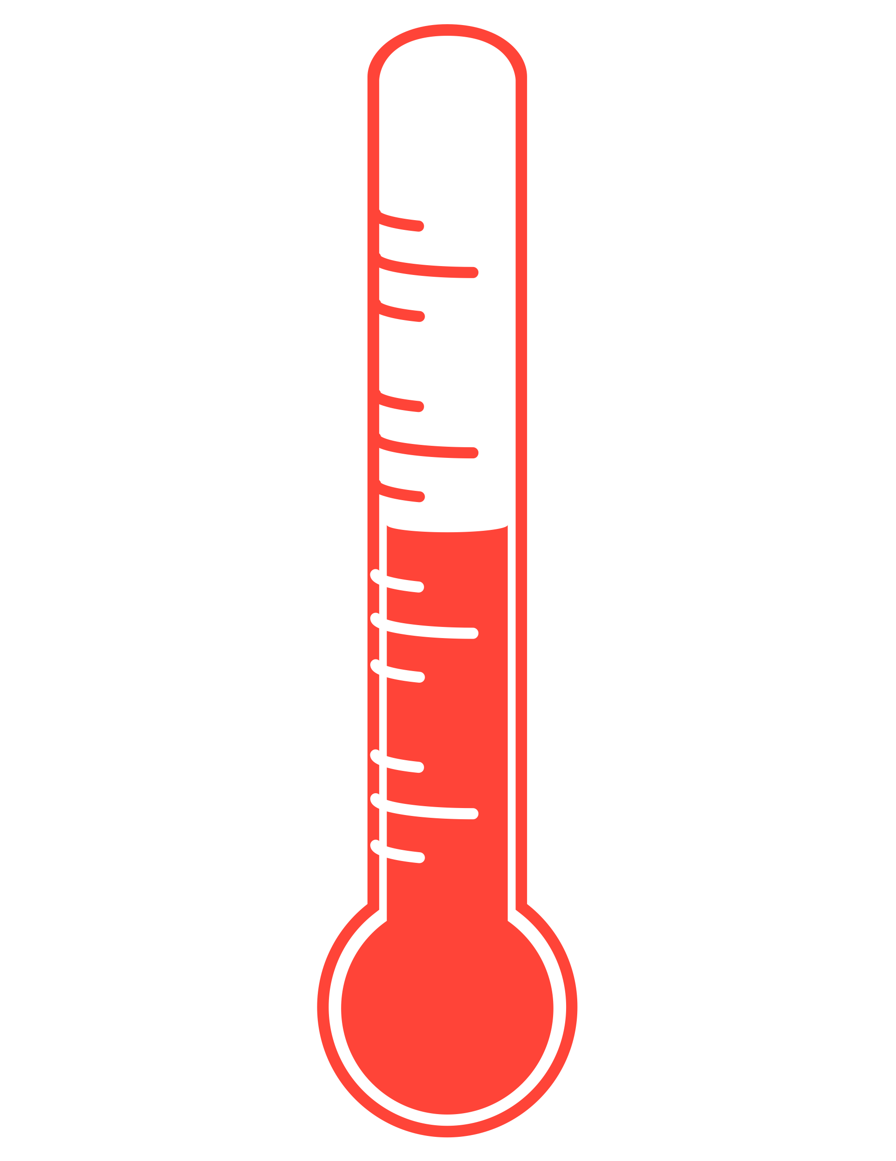
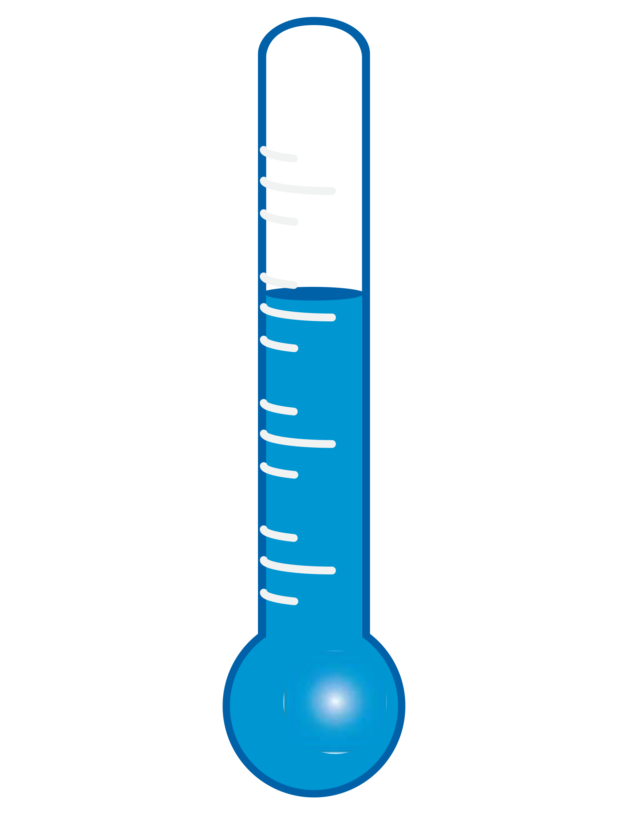
Reproduction: semelparous (reproduce only once)
Hatch time: E dofleini (giant octopus) 150 days to one year depending on temperature
Paralarvae period: 90 days, June-Aug in AI (Kubodera 1991)
Peak spawning: winter to early spring in GOA and AI (Conrath & Conner, 2014; Brewer R.S. 2016)
Optimal growth temperature ~10°C decreasing below or above (Sano&Bando 2018)
Maximum feeding rate: 10-15°C S&B 2018)
EBS: P. cod resident seals, walrus, large sculpins
AI: P.cod, halibut, Atka mackerel
Link to the 2020 Octopus write-up
Link to Octopus Assessment
Main species: Enteroctopus dolfeini
PREDATORS
COMPETITORS
ENVIRONMENTAL PROCESSES
PREY
Giant octopus main prey AI: bivalves (Scheel & Anderson, 2012)
From ADFG: shrimp, crab, scallop, clam, lobster fish
Notes:
Prey (from ADFG website):
“The Giant Pacific Octopus is carnivorous; its diet includes shrimp, crab, scallop, clam, lobster, fish, and soft bodied prey. They have been known to scavenge larger fish and birds.”
Competitors:
Predators:
“This method uses data from the AFSC’s food habits database to estimate the total amount of octopus consumed by their main predator in the BSAI: Pacific cod. Because Pacific cod is an important commercial species, the AFSC food habits group collects a large number of Pacific cod stomachs for diet analysis. The amount of octopus consumed by Pacific cod is a conservative estimate of the total natural mortality N for octopus, since it does not include mortality from other predators (i.e., marine mammals) or non-predation mortality.”

Slide 2
Broad-scale climate patterns reflect a transition from La Niña to El Niño.
Regional SST trends at or near the long-term average.
Impact of El Niño on EBS remains to be seen…
NPI reflects the ALPS where positive values mean:
Weak ALPS, high SLP, calmer conditions
NPI positive for most of 2022
AO measures the polar vortex; transitioned from positive to negative in 2022
Bond (slides 8-11)
SSTs similar to the long-term mean in fall 2022 and spring/summer 2023
SSTs slightly above the long-term mean in winter 2022/2023
MHWs have been brief and infrequent since 2021
Lemagie & Callahan (slides 12-13)
ENVIRONMENTAL PROCESSES
Notes:
Generally positive indicators (return to cooler/normal conditions)

Slide 3
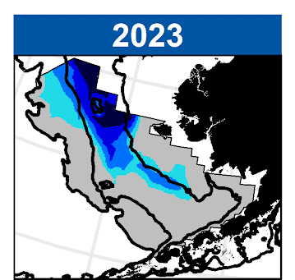
Ice phenology shifted ~1 month later than last year.
Sea ice thickness at or above time series median.
2023 cold pool near historical average.
Ice phenology shifted ~1 month later than last year
Delayed sea ice growth due to slow freeze-up in Chukchi and impact of ex-typhoon Merbok
Ice melt-out slowed by cold April temperatures
Thoman (slides 14-15)
Early season ice extent similar to recent warm years
Ice thickness at or above time series median
2023 cold pool extent was near the historical average
Footprint similar to 2011, 2017, and 2022
Cold tongue along inner front shifted inshore
Bottom & surface temperatures slightly colder
very cold bottom waters south of St. Matthew Island
Coldest bottom waters in southern inner domain since 2013
Rohan & Barnett (slides 16-18)
ENVIRONMENTAL PROCESSES
Notes:
Generally positive indicators (return to cooler/normal conditions)

Slide 4
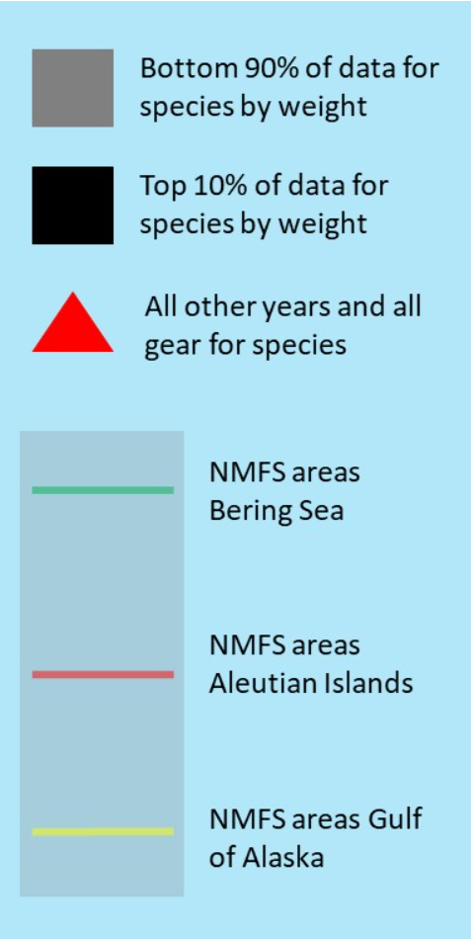
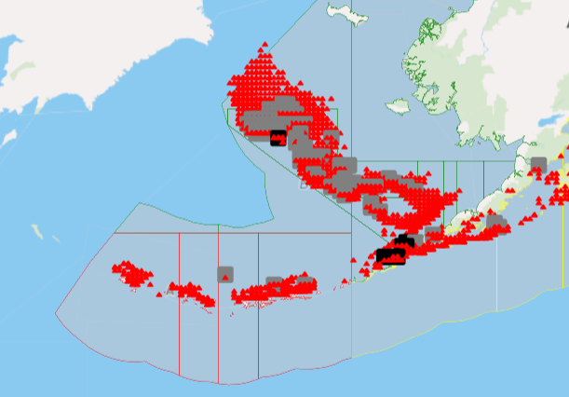
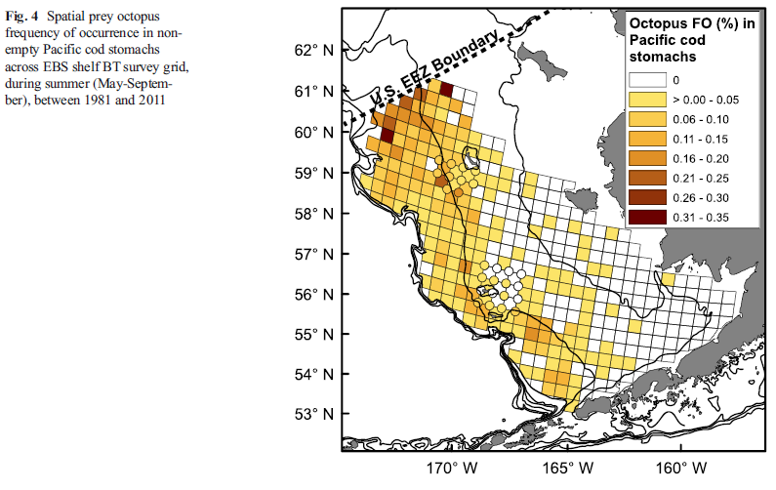
Updated distribution based on bycatch and presence in Pcod stomachs
1993-2022 all gears all years, octopus unidentified, NP Observers Program groundfish data
https://apps-afsc.fisheries.noaa.gov/ords/r/fma_ols/fma-map/home?p1_species_all_gear_year=Y&session=1645770819850

Slide 5
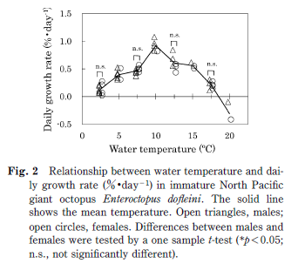
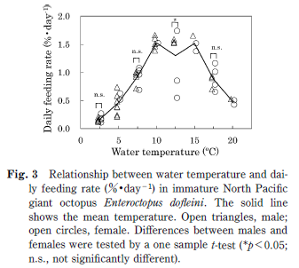
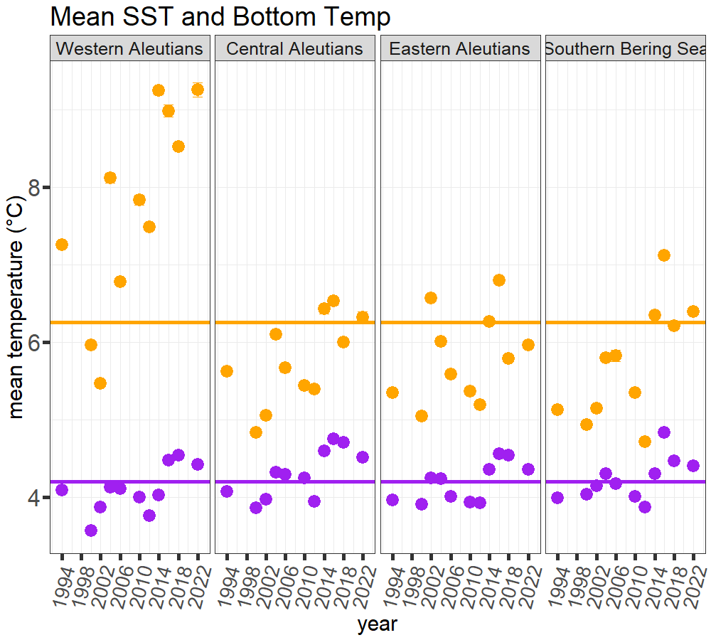
Sano & Bando 2018

Slide 6
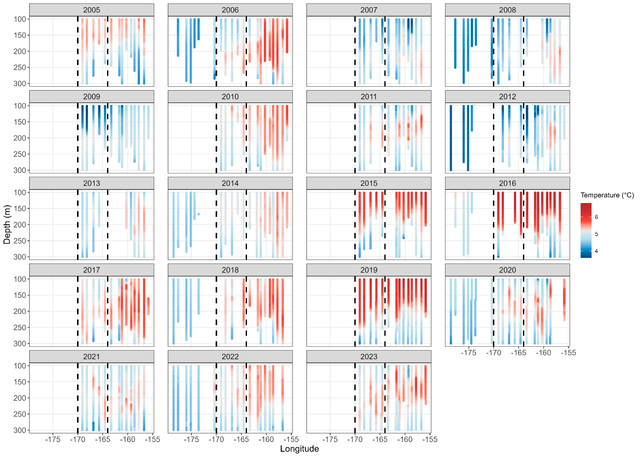
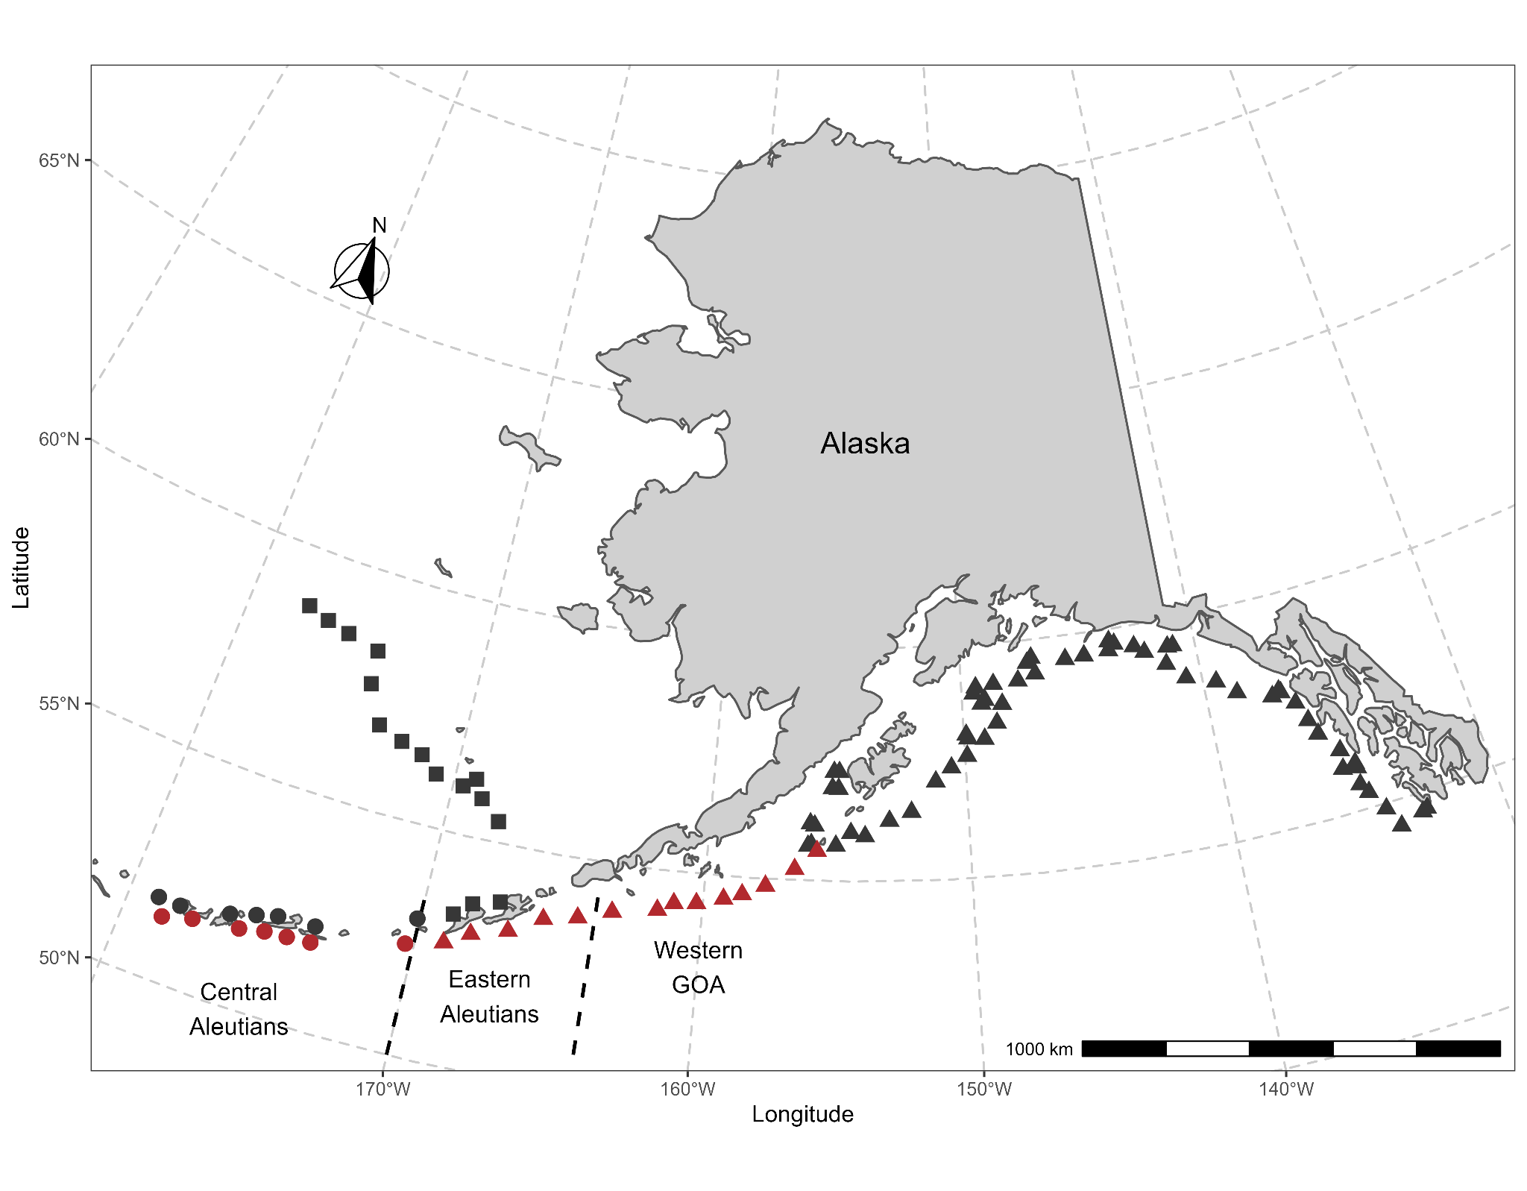
AI longline survey - temperature and trends in bottom trawl survey
EAI: Cooler waters at 100 m, warmer around 150-200 m, cooler temperature below 200 m

Slide 7
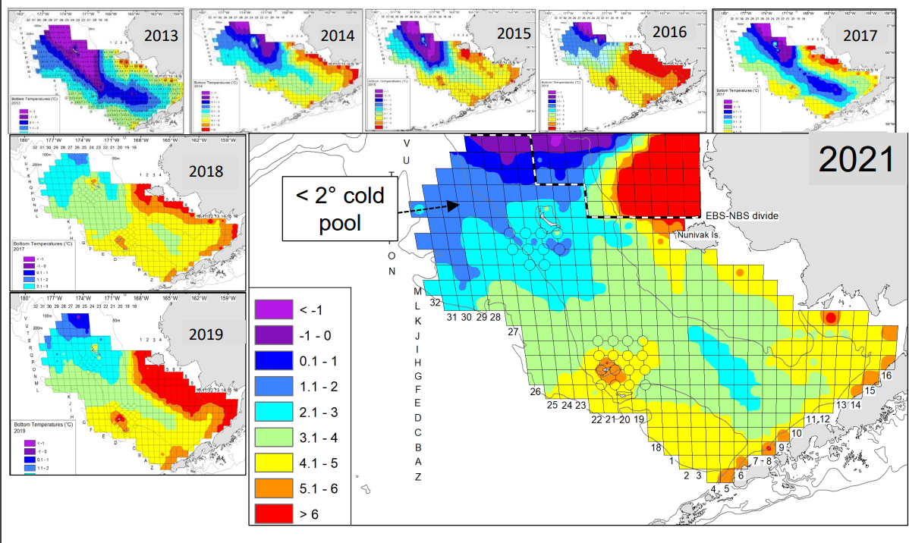
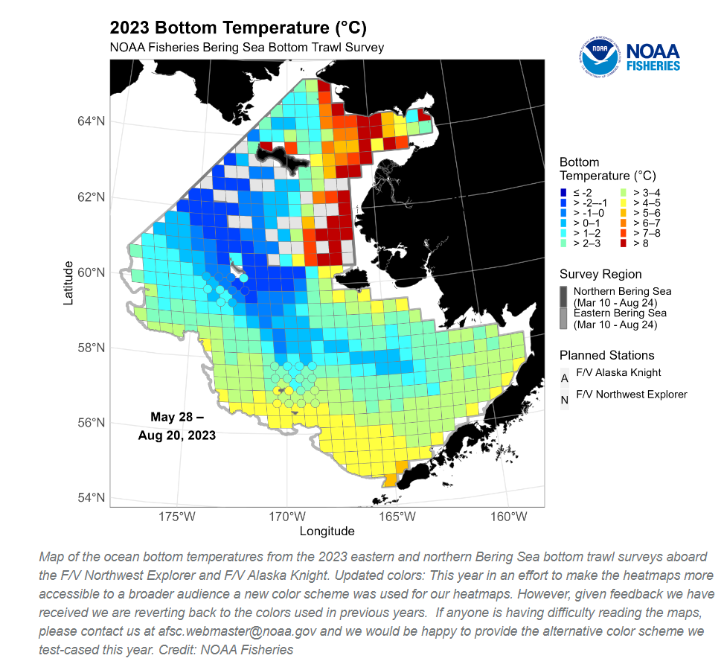
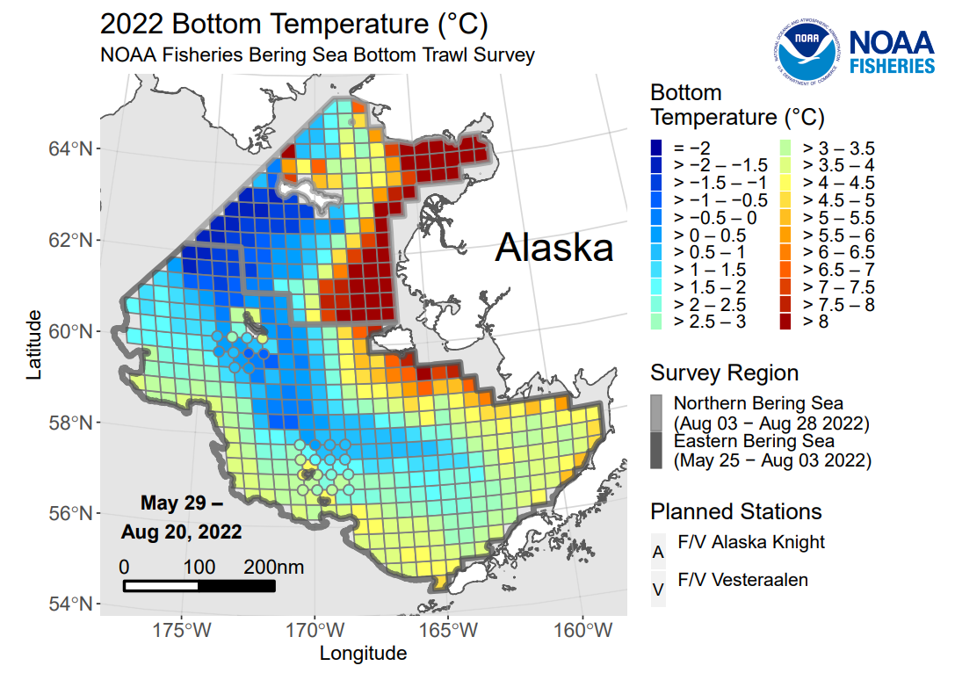
Litzow et al 2021 BTS results for CPT

Slide 8
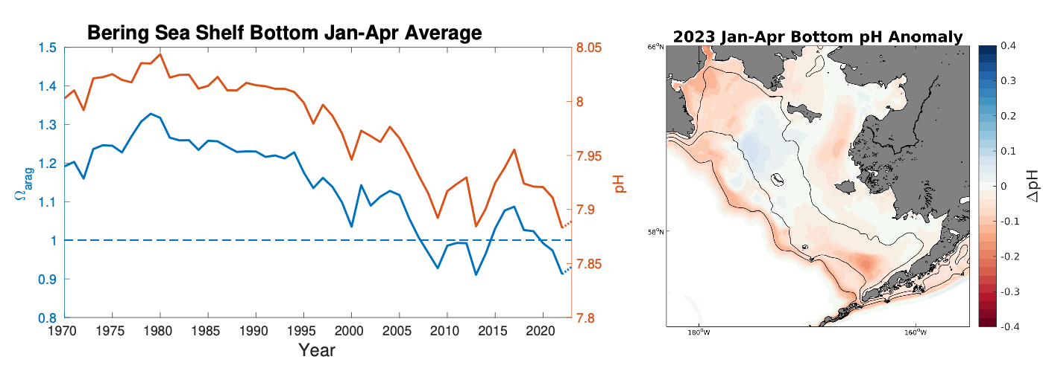
Expansion of bottom water conditions (aragonite and pH)
experimentally shown to negatively impact pteropods and red king crab.
Snow crab appear resilient to OA; Bristol Bay nearshore regions appear buffered.
2023: Ωarag and pH continuing near lowest values
Multi-year outer shelf low pH anomaly diminished somewhat
Long-term decrease means expansion of bottom water conditions experimentally shown to negatively impact growth and survival of pteropods and red king crab
Pilcher & Monacci (slide 19)
ENVIRONMENTAL PROCESSES
Notes:
Horizontal line represents experimental thresholds below which impacts were observed in lab studies.
We don't currently think that OA is impacting the Bristol Bay red king crab fishery and is not the main driver of snow crab declines.
Indirect effects (maybe not for crab, but other parts of the ecosystem): Ωarag is critical threshold for pteropod shell formation.

Slide 9
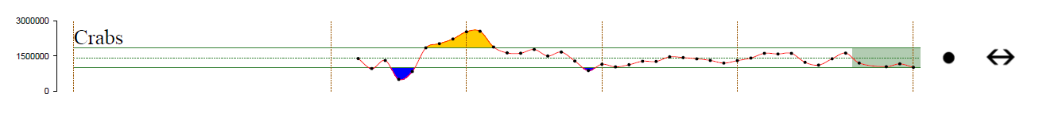
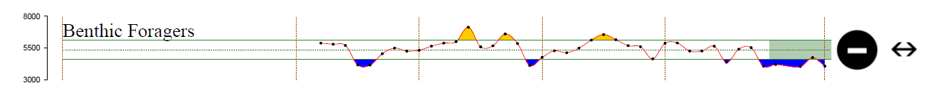
It is difficult to directly assess prey availability for octopus.
Crabs are one known prey resource and those populations are low.
Indirect measures based on benthic foragers indicates reduced infaunal prey available.
Shrimp: no direct measures
Crabs: remain below long-term mean, but within ±1SD
Benthic infauna: indirect measure; remain below long-term mean and below -1SD
PREY

Slide 10
Competitors?
For adult/ large octopi: Halibut, Pacific cod
Halibut stock remains low since early 2000 peak, so no increase in competitor pressure
COMPETITORS

Slide 11
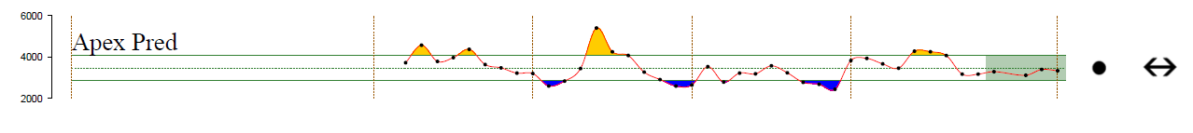
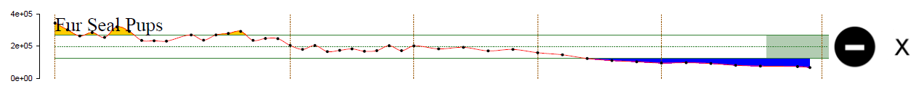
Predators
Apex predators (includes PCod): at long-term mean; PCod had modest increase from 2022 to 2023.
Fur seal pups (at St. Paul): long-term declining trend
Seabirds (at Pribilofs): mixed trends with better reproductive success at St. George than St. Paul Island
Steller sea lions in the Aleutian Islands, particularly in winter. SSL decreasing in Western and Central AI.
Occasional predators in AI include halibut and Atka mackerel
PREDATORS

Slide 12
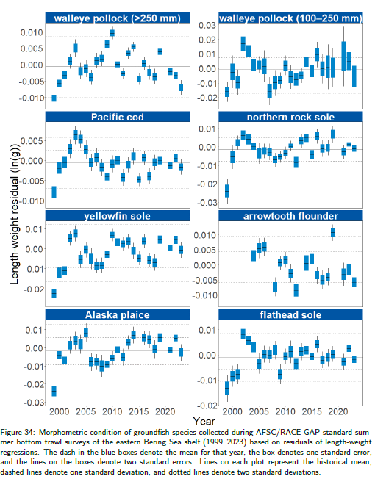
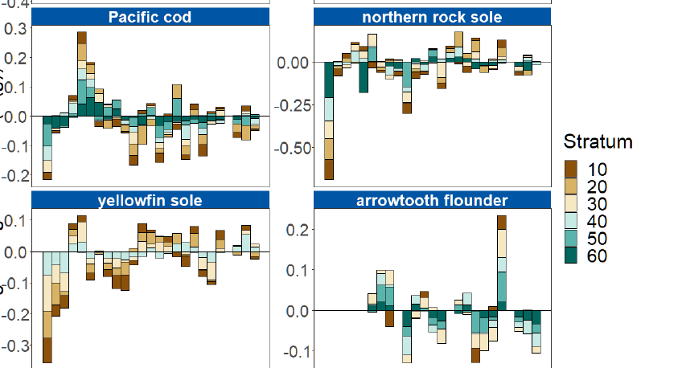

Slide 13
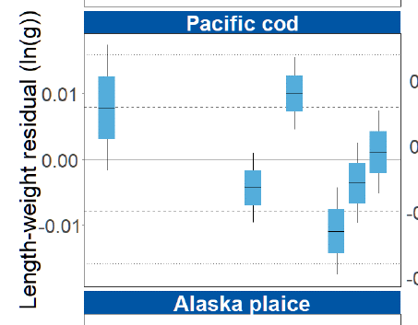
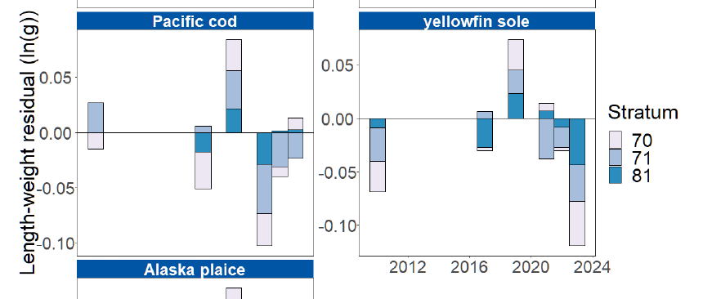

Slide 14
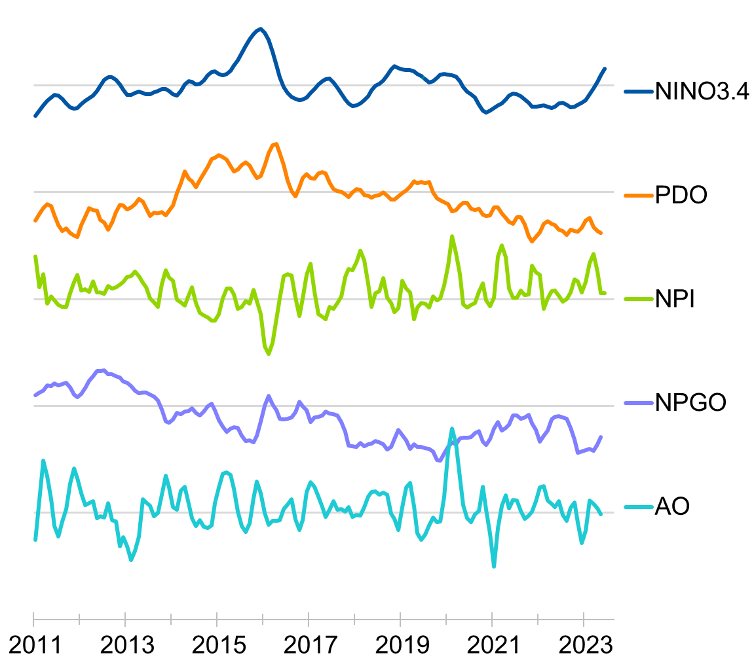
North Pacific Climate Indices
Bond
NPI reflects the ALPS where positive values mean:
Weak ALPS, High SLP, Calmer conditions
NPI positive for most of 2022
Linked with extended La Niña and decline in PDO
AO measures the polar vortex; transitioned from positive to negative in 2022
Negative AO usually leads to Arctic air, but late 2022 had warm weather north of AK
Notes:
Each slide will have a topic and a contributor name in the top right corner.
All contributors have graciously provided their information and expert interpretation of the trends for you.
Thank you to all contributors!
Starting broadly:
Nick Bond provides 5 climate indices for the NoPAc, 2 of which best describe the conditions in the EBS: NPI and AO
NPI: For most of 2022, reflective of the la nina (triple dip) we had been experiencing. End of time series start to see shift into upcoming el nino conditions
AO: Also transitioned in 2022/2023

Slide 15
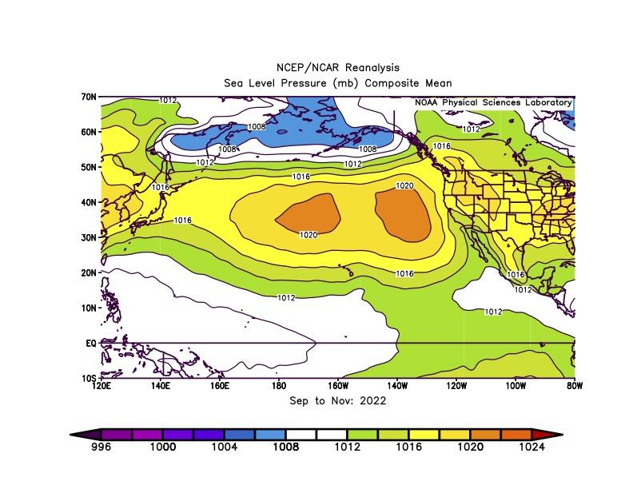
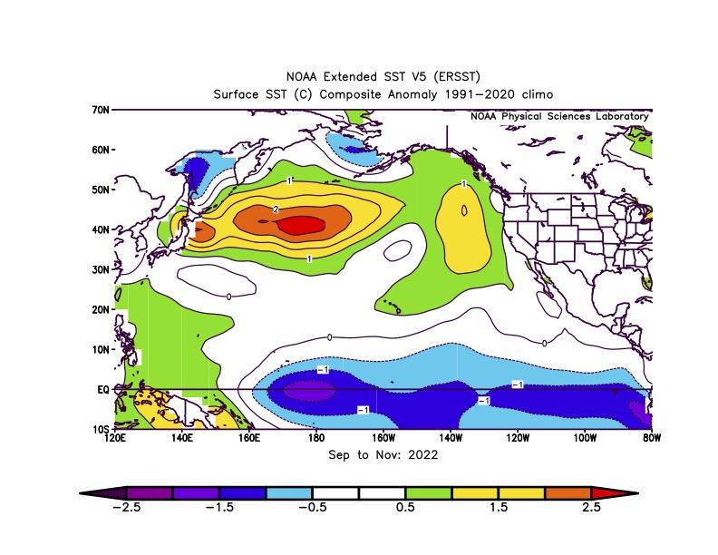
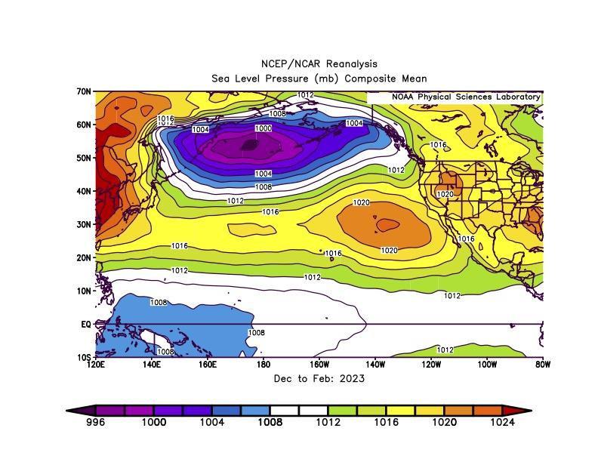
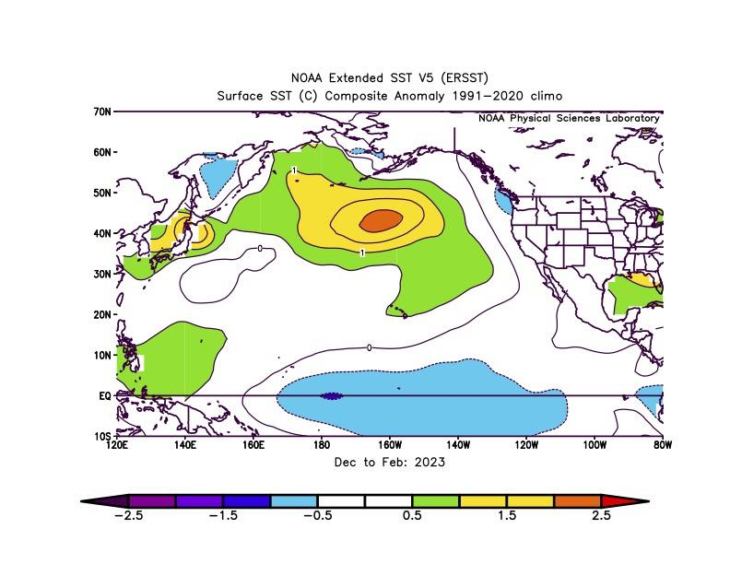
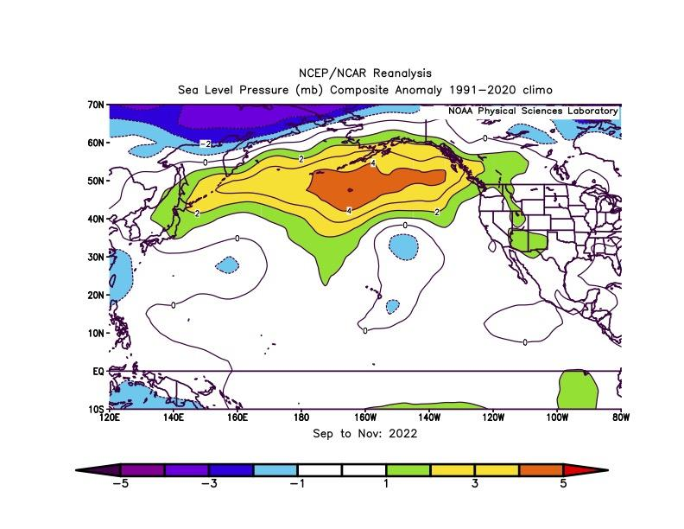
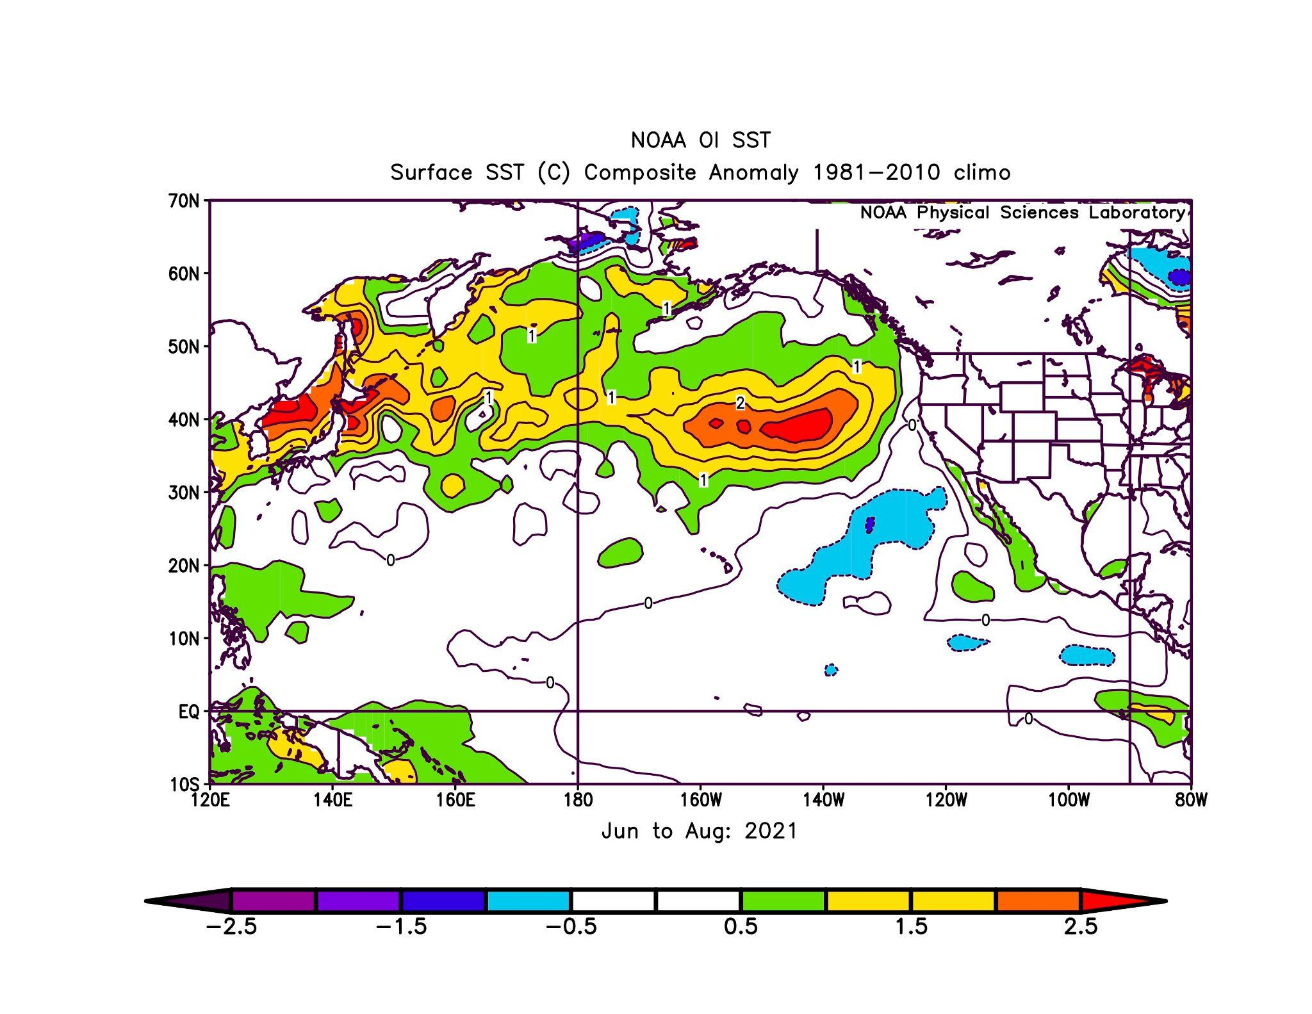
Fall & Winter 2022/2023 SLP & SST
Bond
SLP
SST
High SLP across North Pacific; lower SLP from Siberia to Chukchi Sea.
Winds from the west across the Bering Sea.
Cool tropical Pacific associated with La Niña.
Cool SST conditions on EBS shelf.
Fall
ALPS shifted west. Winds from the west from Sea of Okhotsk to eastern Aleutian Islands.
La Niña weakened.
Average SSTs on EBS shelf.
Winter
From the NCEP/NCAR Reanalysis project
Notes:
Winds blow clockwise around high pressure and counterclockwise around low pressure
Top row: Fall 2022
Left: SLP (winds) from the west which brought
Right: cool SST on the EBS shelf. Can see the cooler colors/temps along the equator that denote the La Nina last fall
Bottom row: Winter 2022/2023
Left: Deep purple is the ALPS and it was shifted went and continued to bring winds from the west over the shelf
Right: Average SSTs in EBS. La Nina weakened

Slide 16
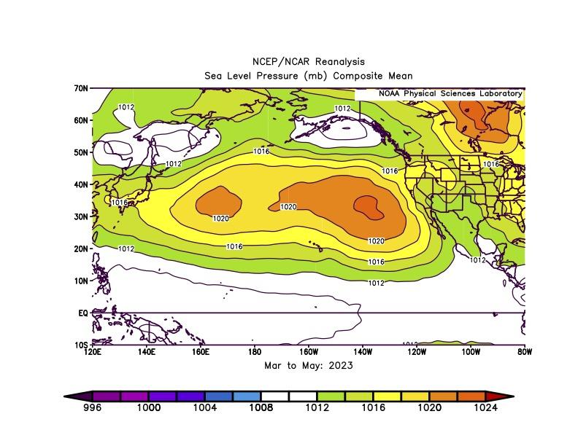
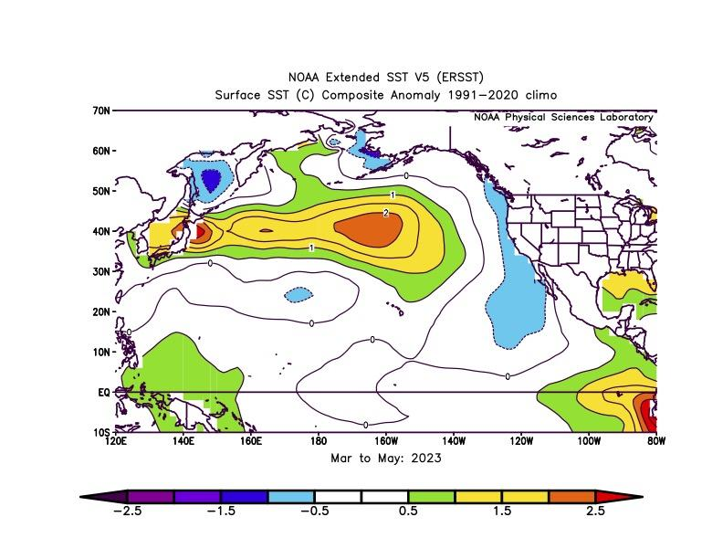
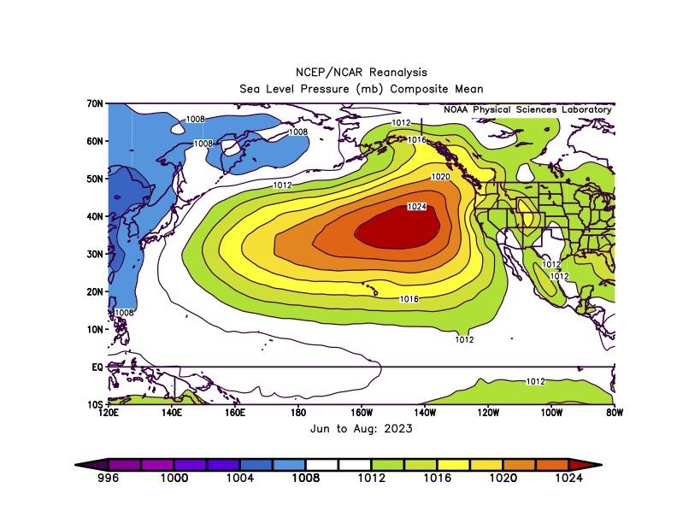
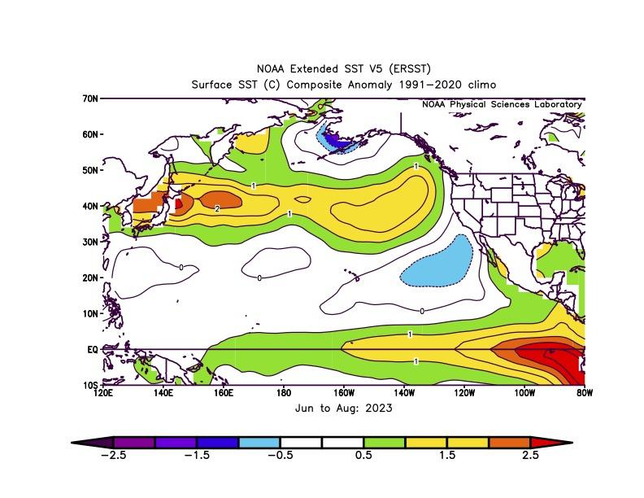
Spring & Summer 2023 SLP & SST
Bond
SLP
SST
High SLP in North Pacific. Winds from the west across most of the Bering Sea.
Average SSTs in tropical Pacific.
Return of cool SST conditions on EBS shelf.
Spring
Dipole in western North Pacific: lower SLP from Sea of Okhotsk to Alaska and higher south of 40˚N. Southwesterly winds between dipole.
Strong warming in tropical Pacific defined El Niño in June 2023.
Continuation of cool conditions on EBS shelf.
Summer
From the NCEP/NCAR Reanalysis project
Notes:
Top row: Spring 2023
Left: Continued high SLP in NP and winds from the west over the EBS shelf
Right: Now average SST along the equator and return to cool temps in EBS
Bottom row: Summer 2023
Left: Winds shift from west to southwesterly
Right: Warming along equator and development of El Nino. Though through summer, continued cool conditions for EBS shelf

Slide 17
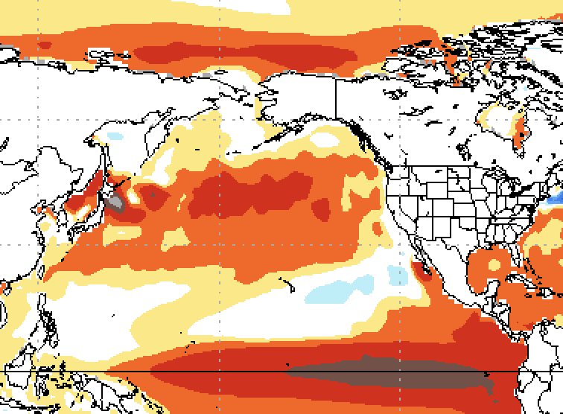
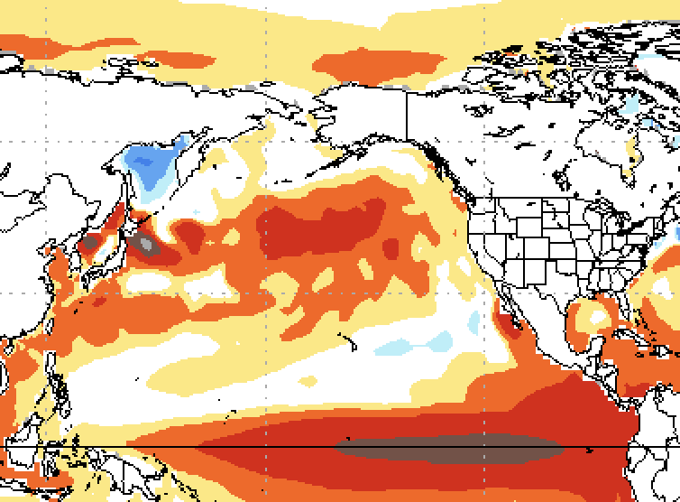
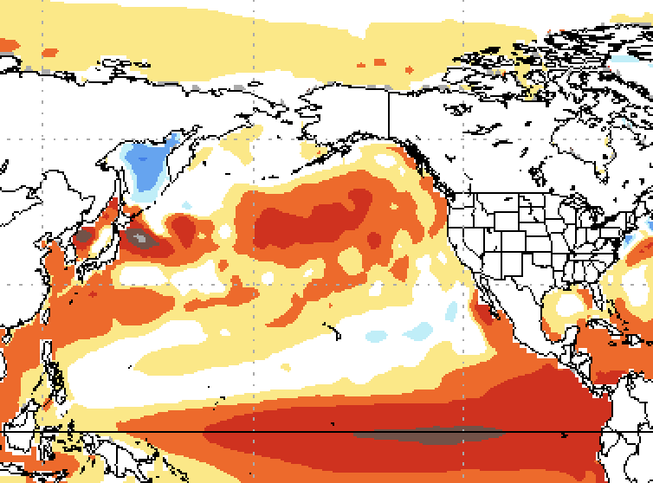
SST Projections from the National Multi-Model Ensemble
Bond
Oct - Dec 2023
TOP: El Niño in tropical Pacific. Modest warming for western Aleutian Islands, southeast Bering Sea shelf, and Gulf of Alaska.
MIDDLE: Similar to earlier period (Oct-Dec 2023). Tropical Pacific has SST anomalies >2˚C, representing a strong El Niño.
BOTTOM: Moderation of tropical Pacific SSTs; warming along PNW coast and SEAK (typical response to El Niño). Sea ice could extend south of 60˚N and as far south as Bristol Bay.
Dec 23 - Feb 24
Feb - April 2024
Notes:
NMME represents the average of eight climate models

Slide 18
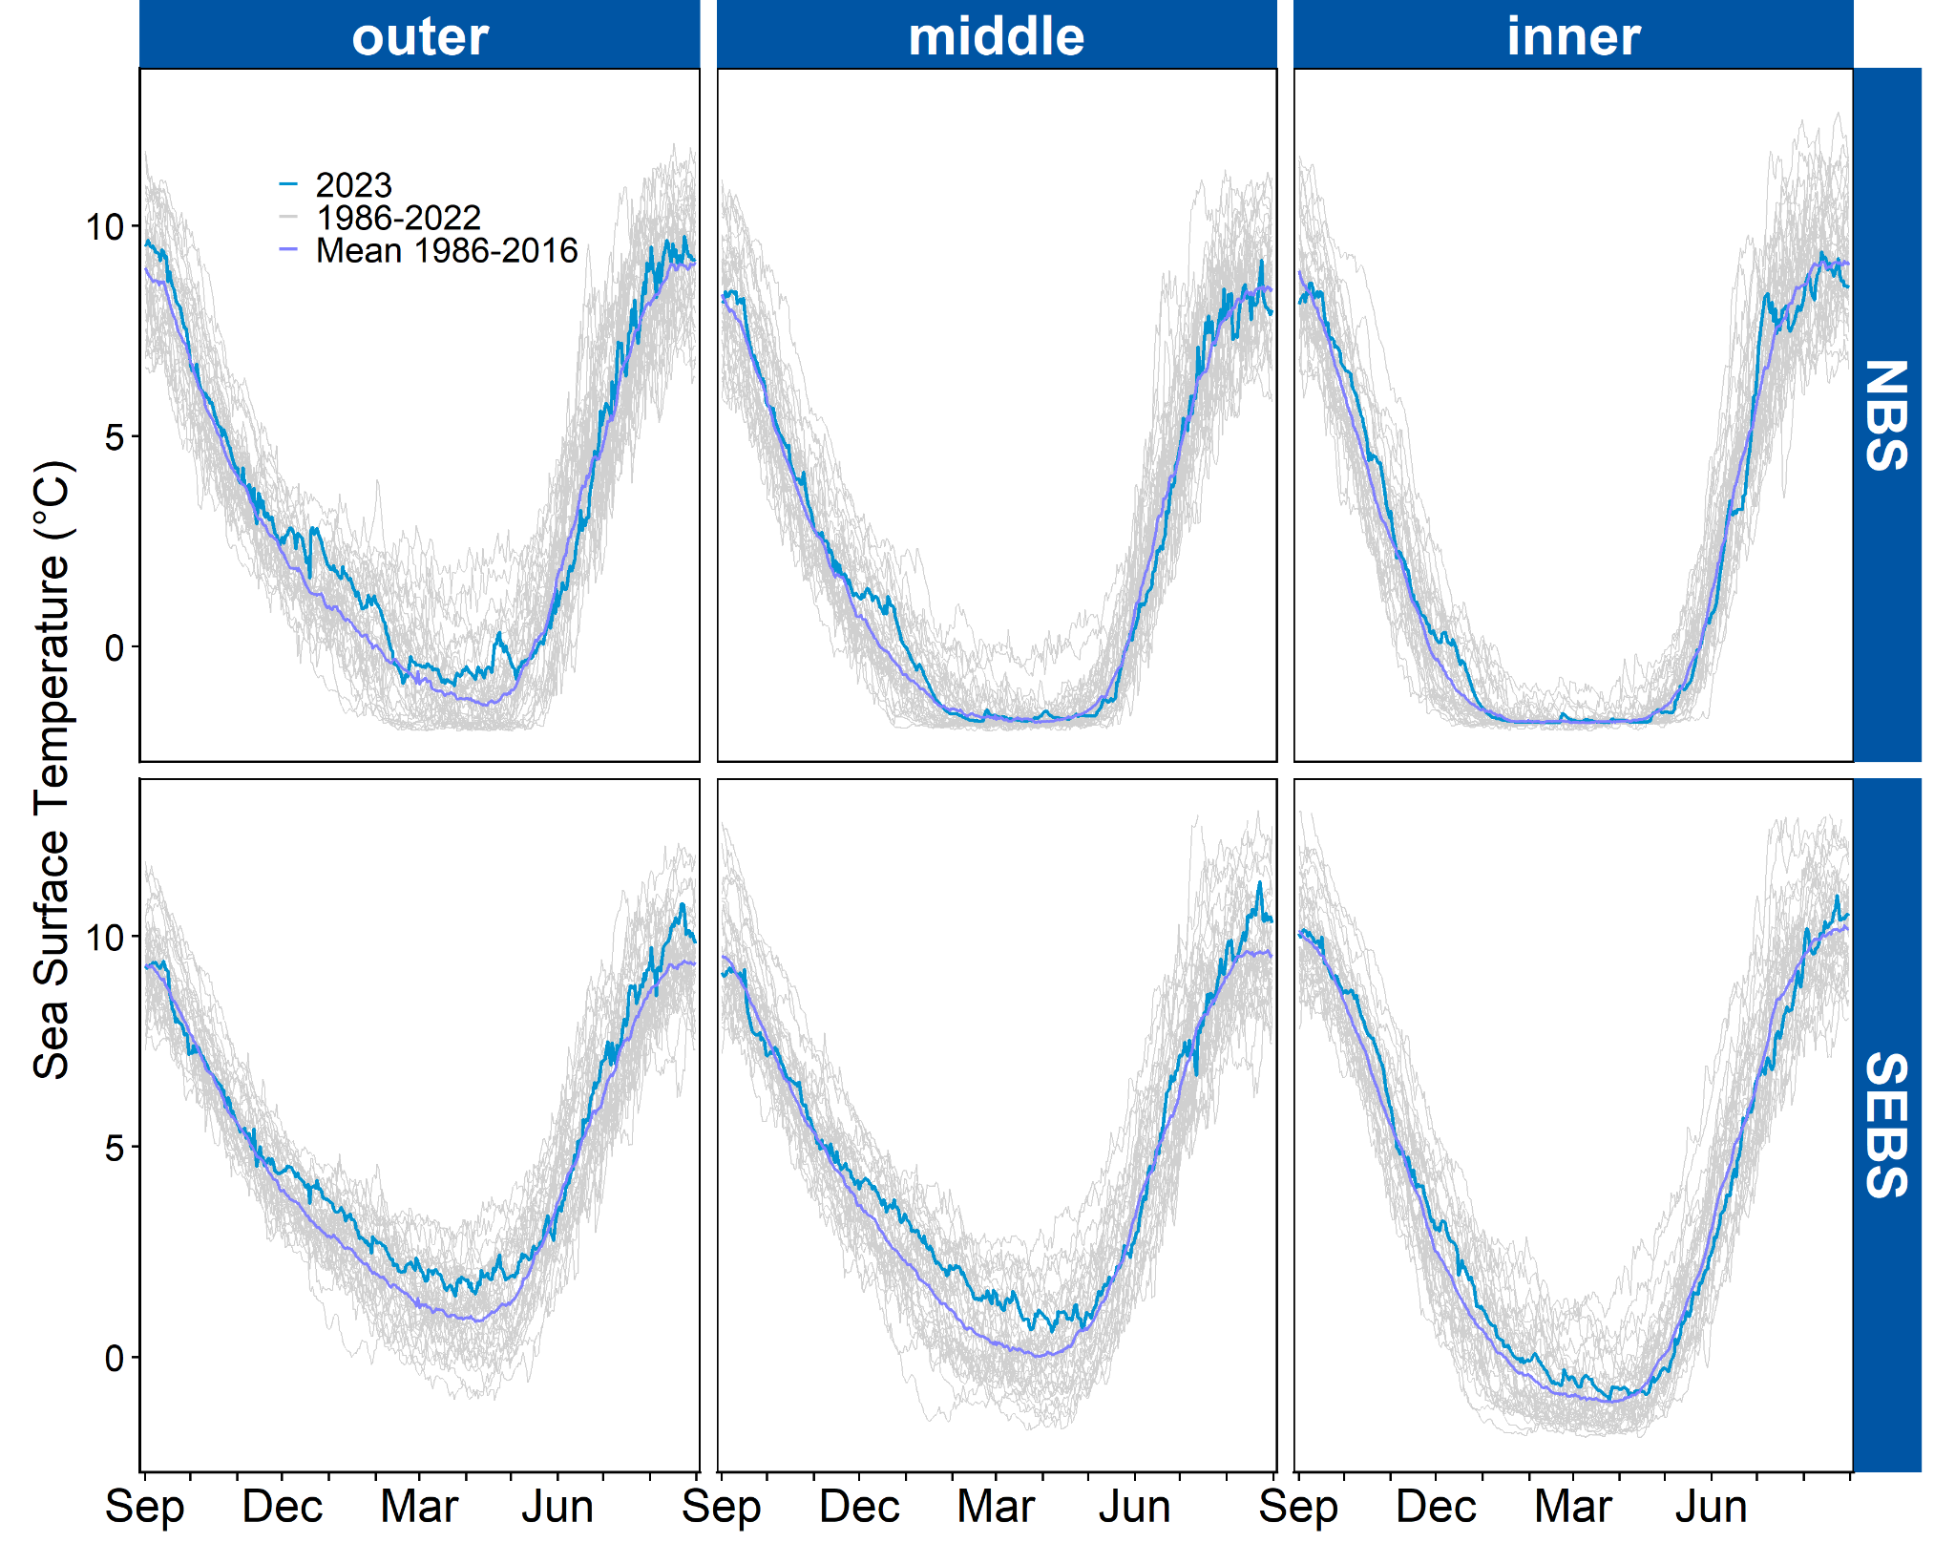
Sea Surface Temperature
Lemagie & Callahan
SSTs were similar to the long-term mean in fall 2022 and spring/summer 2023
SSTs were slightly above the long-term mean in winter 2022/2023, especially in the outer domain and southern middle domain
Notes:
Getting close to home, Emily and Matt provided SST over the year by DOMAIN for the NBS and SEBS.
Updated through August 2022
Data for the shelf (10-200m)
Sea ice = -1.8C

Slide 19
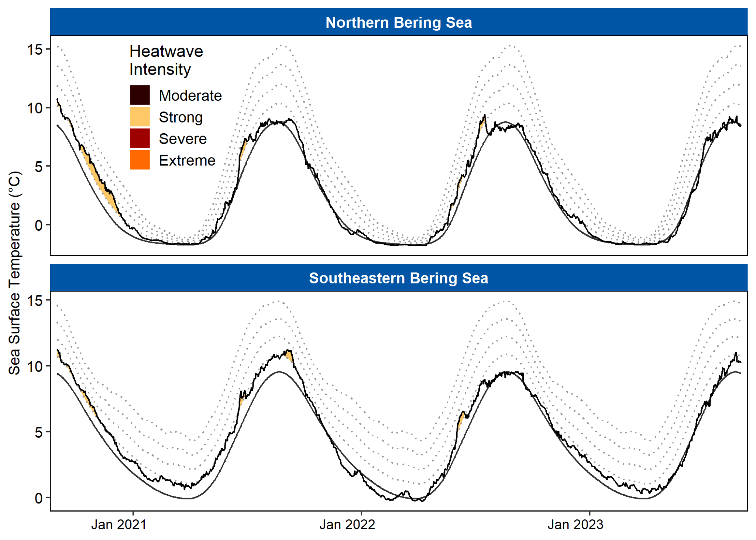
Marine Heatwave Index
Lemagie & Callahan
MHWs have been brief and infrequent since 2021
Notes:
MHWs = daily SST exceeds 90 percentile of normal for 5 consecutive days

Slide 20
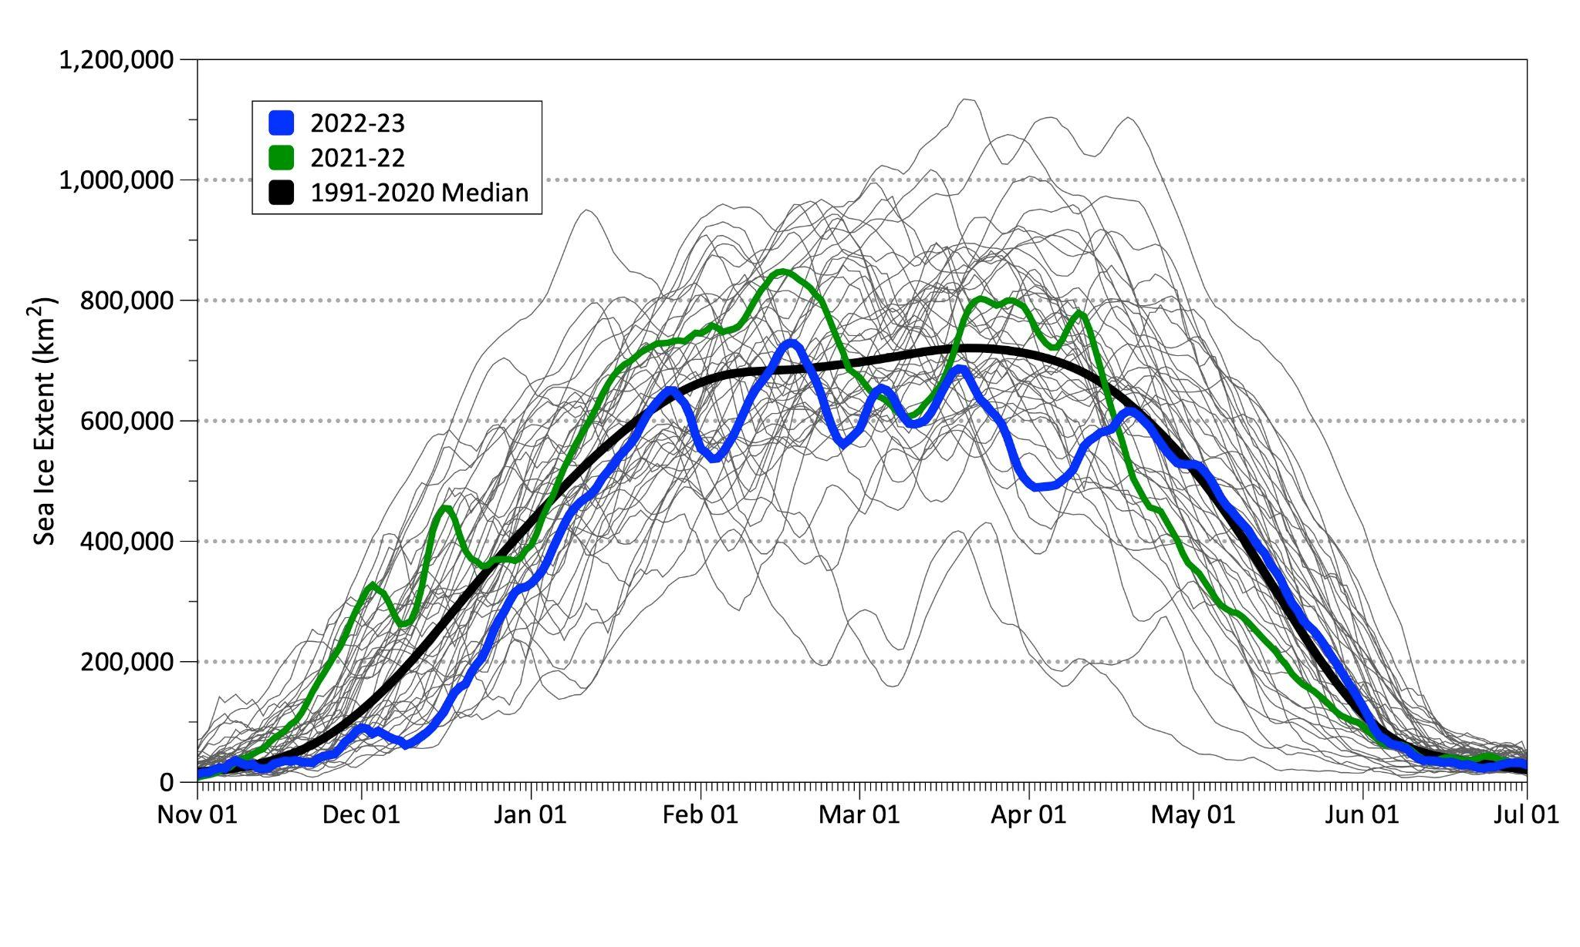
2023 Sea Ice
Thoman
Ice phenology shifted ~1 month later than 2021/2022
Delayed sea ice growth in Nov & Dec:
Stormy weather
Slow freeze-up in the Chukchi
Impact of Merbok (next slide)
Ice melt-out in spring was slowed by cold April temperatures
Maximum ice extent occurred February 17; sea ice did not reach St. Paul Island (9th year in past decade)
Notes:
Now onto ice
Orient to figure (axes, spaghetti lines, colors for years)
Then walk through bullets on the slide

Slide 21
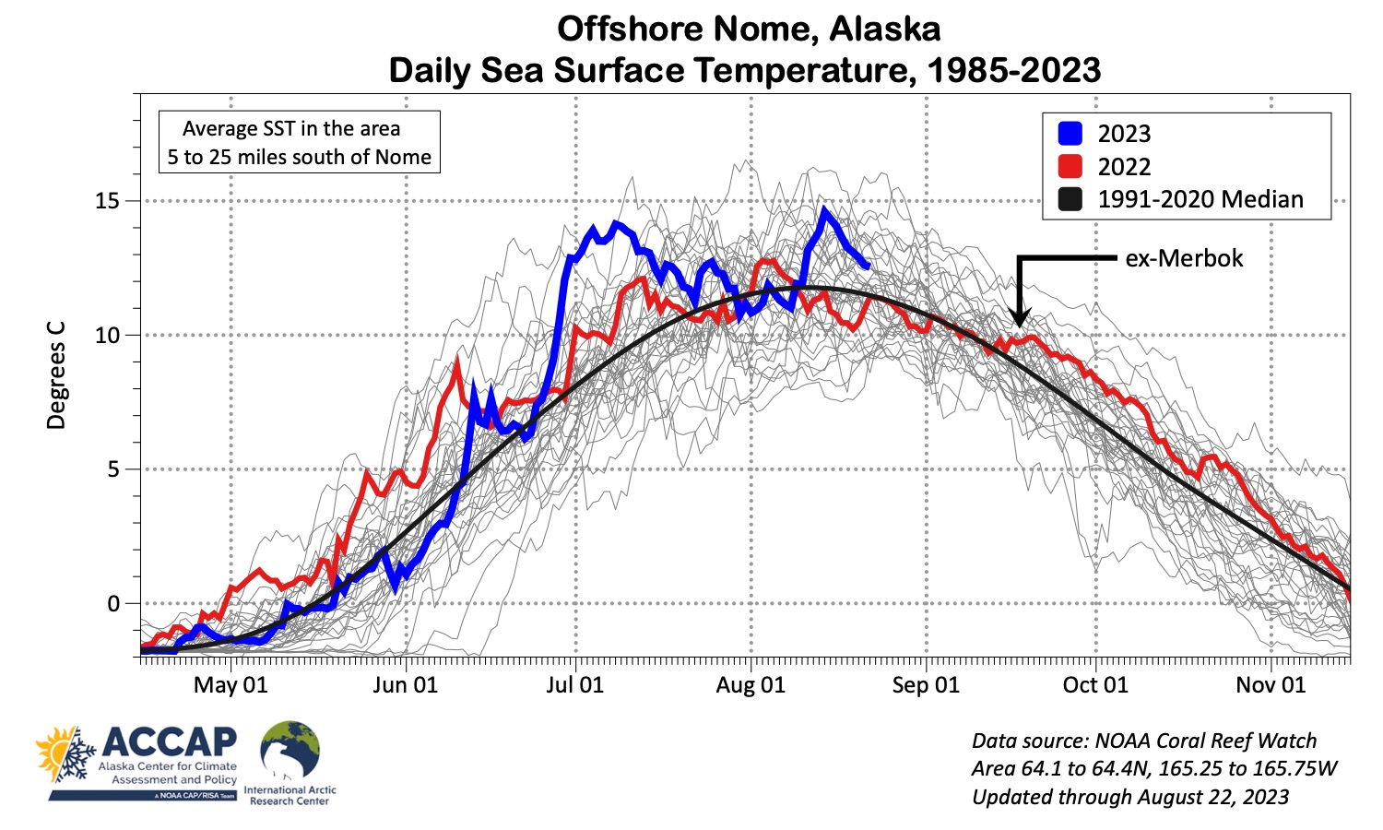
2023 Sea Ice
Thoman
Ice phenology shifted ~1 month later than 2021/2022
Delayed sea ice growth in Nov & Dec:
Stormy weather
Slow freeze-up in the Chukchi
Impact of Merbok (next slide)
Ice melt-out in spring was slowed by cold April temperatures
Maximum ice extent occurred February 17; sea ice did not reach St. Paul Island (9th year in past decade)
Notes:
Now onto ice
Orient to figure (axes, spaghetti lines, colors for years)
Then walk through bullets on the slide

Slide 22

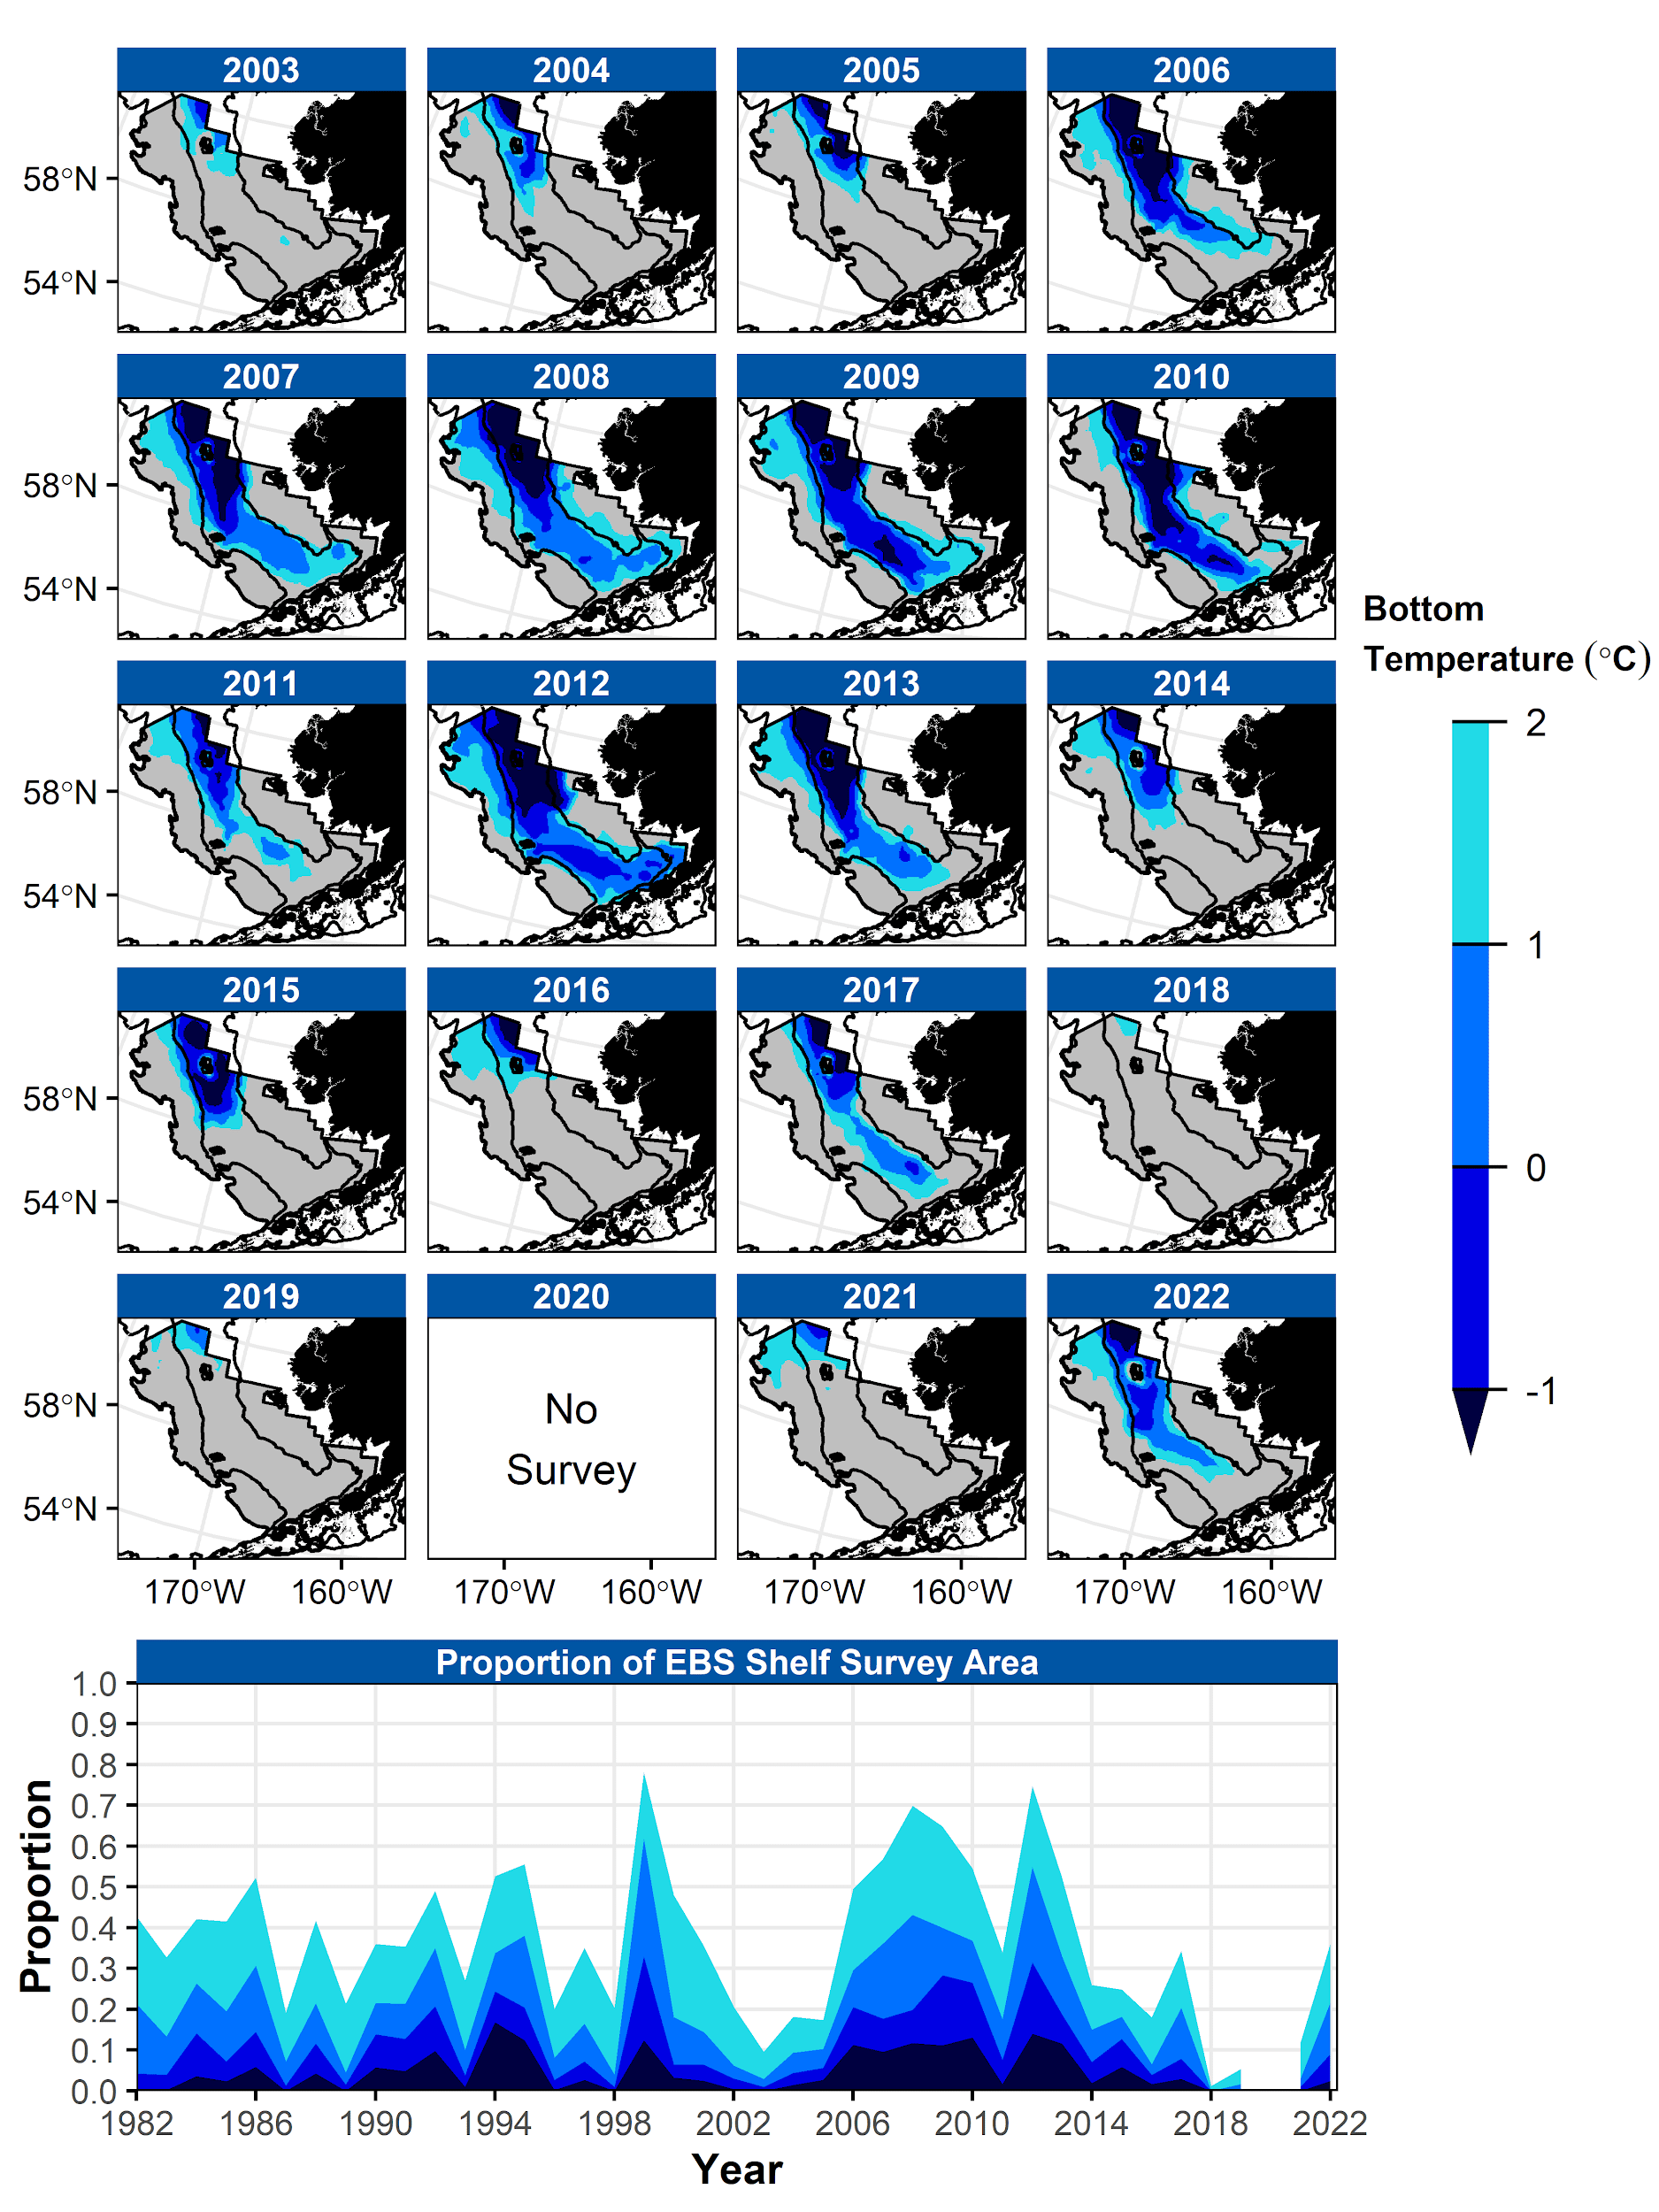
Cold Pool
Rohan & Barnett
Average cold pool extent
Slightly larger than 2022
Footprint of the cold pool was similar to 2011, 2017, and 2022
Cold tongue along the inner front was shifted inshore

Slide 23
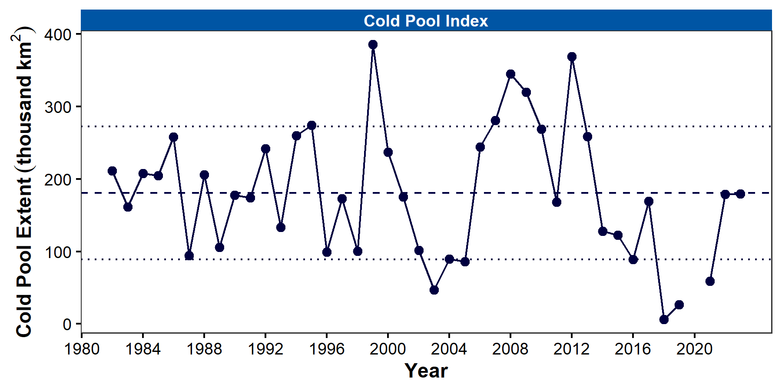
Cold Pool
Rohan & Barnett
Average cold pool extent
Slightly larger than 2022
Footprint of the cold pool was similar to 2011, 2017, and 2022
Cold tongue along the inner front was shifted inshore

Slide 24
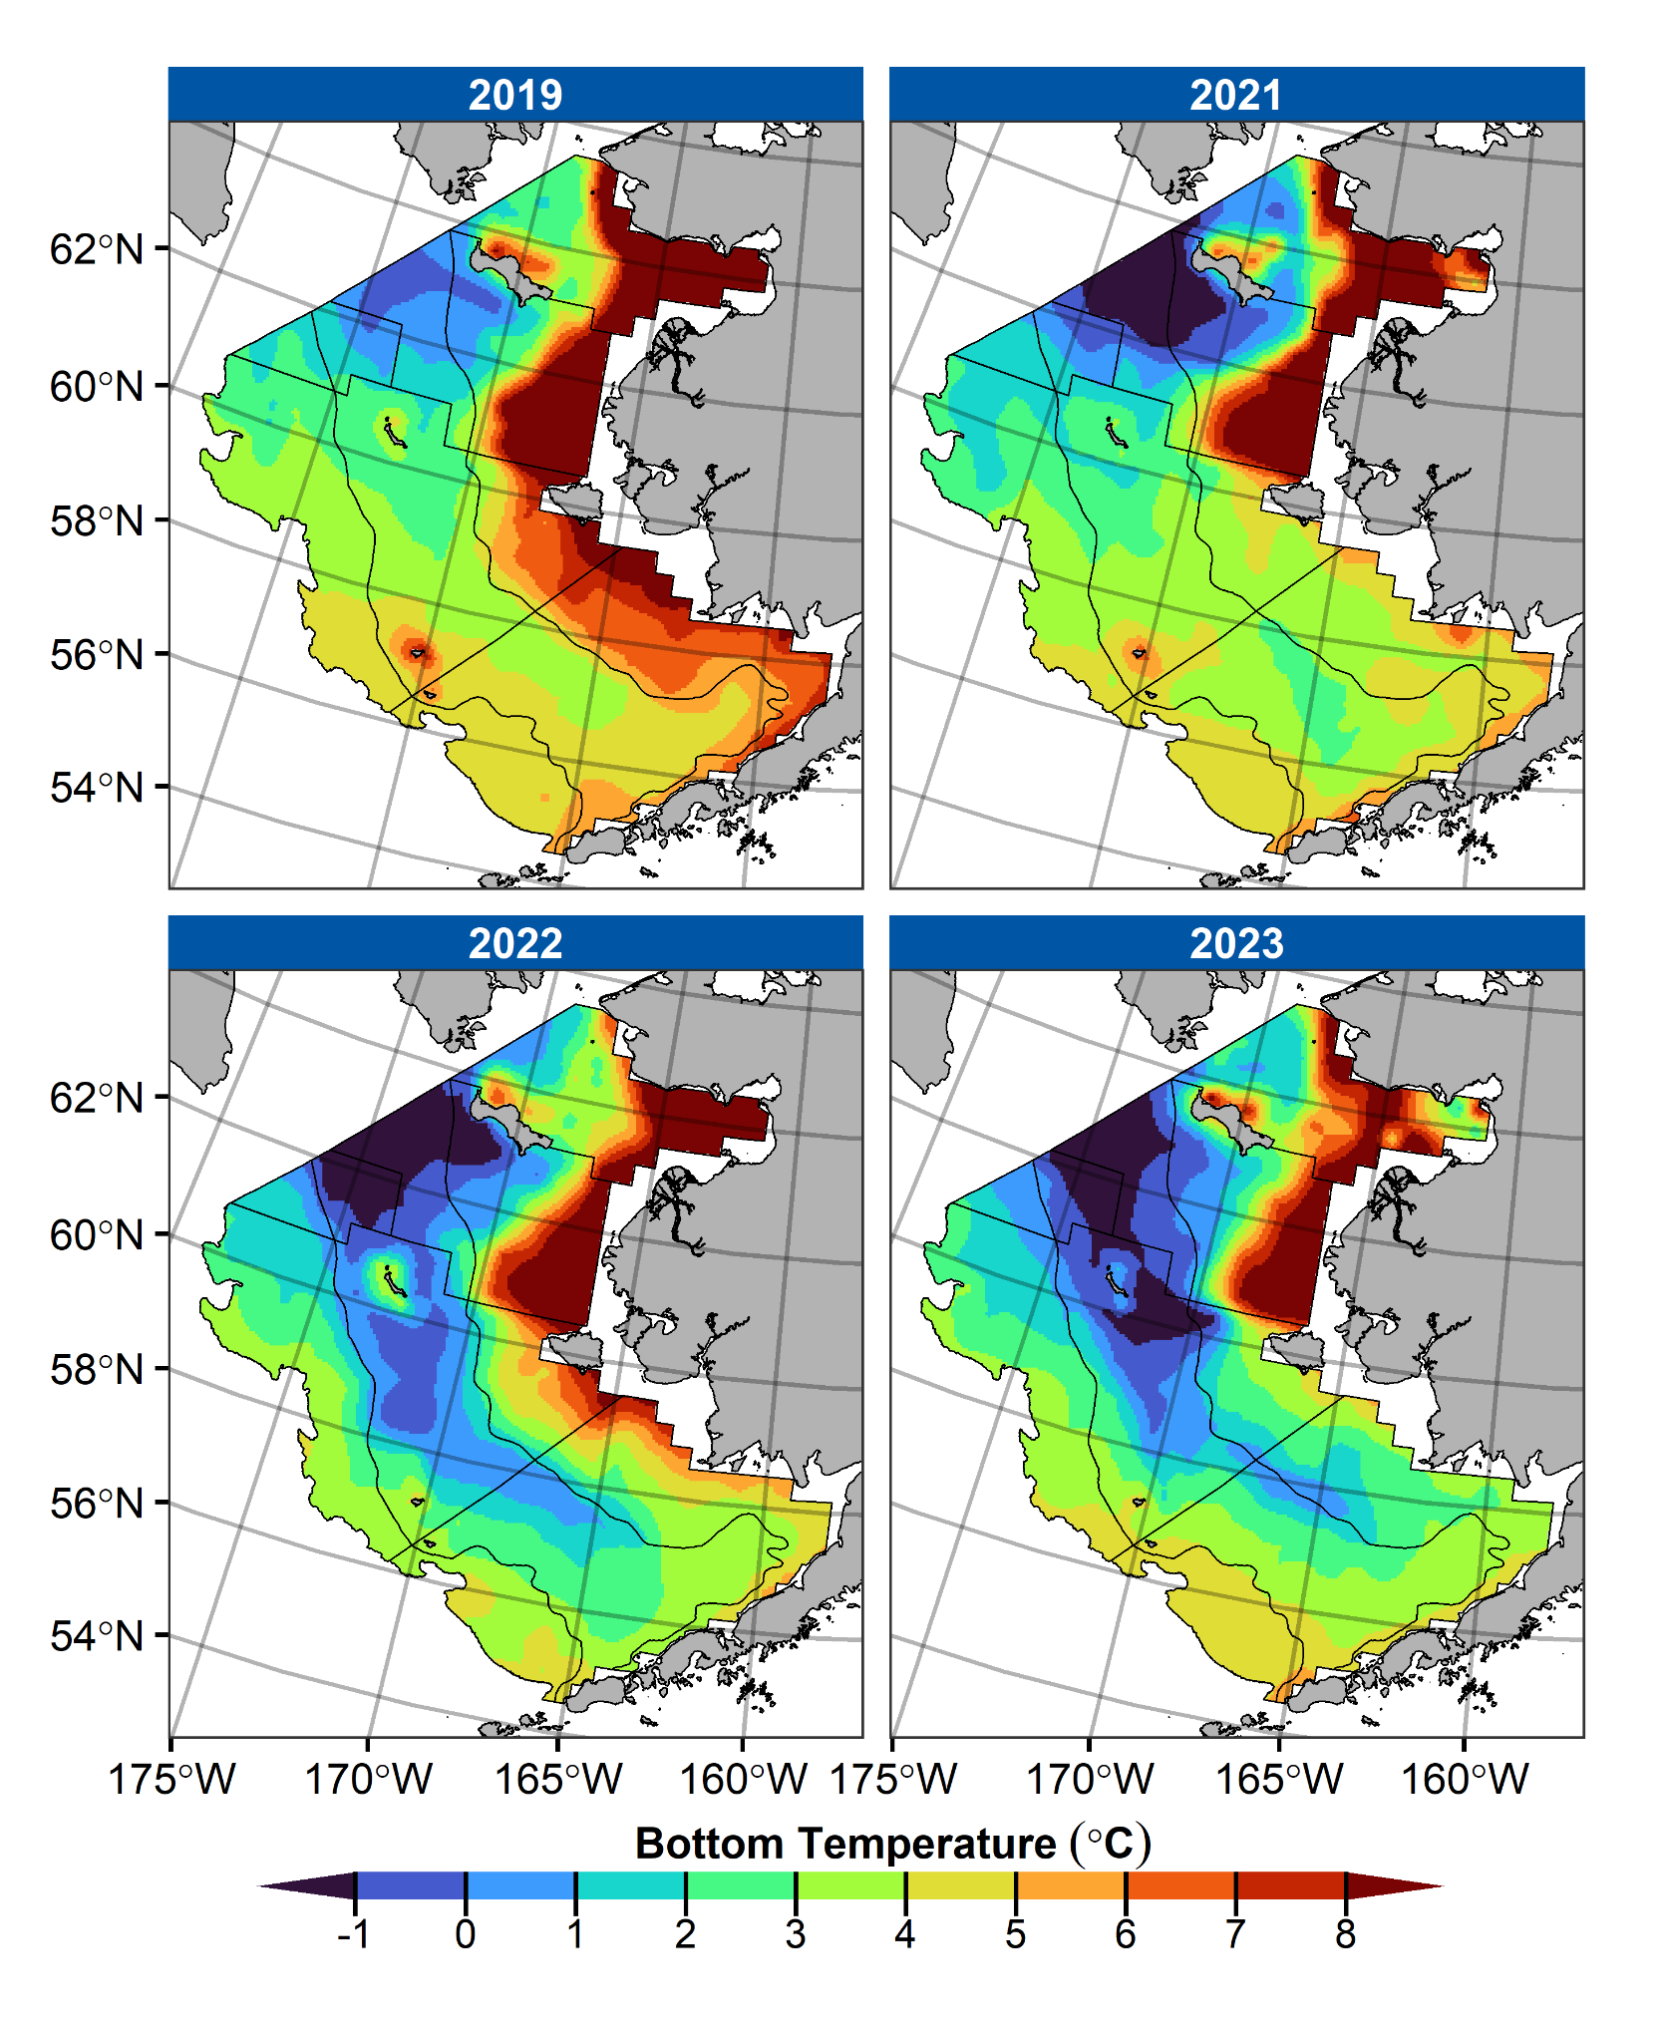
Cold Pool
Rohan & Barnett
Bottom and surface temperatures were slightly colder than time series average
Very cold bottom temperatures south of St. Matthew Island for the first time since 2015
Coldest bottom temperatures in the southern inner domain since 2013
Notes:
Not just about sheer extent of cold pool, but where it was
Spatial variability in bottom temps over the shelf
**No NBS surface temperature yet for 2023 because data aren't finalized.

Slide 25
EBS Ocean Acidification
Pilcher & Monacci
Through Jan-Apr of 2023, Ωarag and pH continuing near lowest values
Multi-year outer shelf low pH anomaly diminished somewhat, though still present in southeastern shelf
Notes:
Lastly, and I’ve included this in the environmental process, but really a metric of habitat
OA
More on this through ESPs
From Darren:
Snow crab: From lab experiments, snow crab appear to be resilient to OA so we don't have any indication currently that OA is a driver of the recent snow crab crash
BBRKC: Growth and survival of larvae and juveniles is negatively impacted at pH values < 7.8. Model suggests that Bristol Bay is relatively more buffered with higher pH values, particularly in the more nearshore regions that the juveniles likely live in. Thus from my conversations with Chirs Long, we don't think that OA is impacting the Bristol Bay red king crab fishery yet.
Indirect effects (maybe not for crab, but other parts of the ecosystem): Ωarag is critical threshold for pteropod shell formation.
For ENSO: the model tends to associate warmer years with higher Ωarag and pH values and vice versa for cold years. This is fairly visible in the timeseries plot on the slide, as Ωarag and pH values were really low during the cold years and then rebounded quite a bit in 2016-2018 during the warmer years. There's a few reasons for this. First, temperature has a fairly strong direct effect on Ωarag due to solubility, so warm temperatures increase Ωarag and cold temperatures decrease Ωarag (note this is just for Ωarag, temperature has a much lower impact on pH comparatively) There's also a biological effect, since the model simulates more carbon uptake in cold years due in part to a stronger fall phytoplankton bloom. This is further compounded if there is relatively high sea ice immediately afterwards, since sea ice blocks air-sea gas exchange at a time when the shelf is typically effluxing carbon back to the atmosphere. So, the system takes up more carbon in fall and then traps it over winter.

